Slide 1
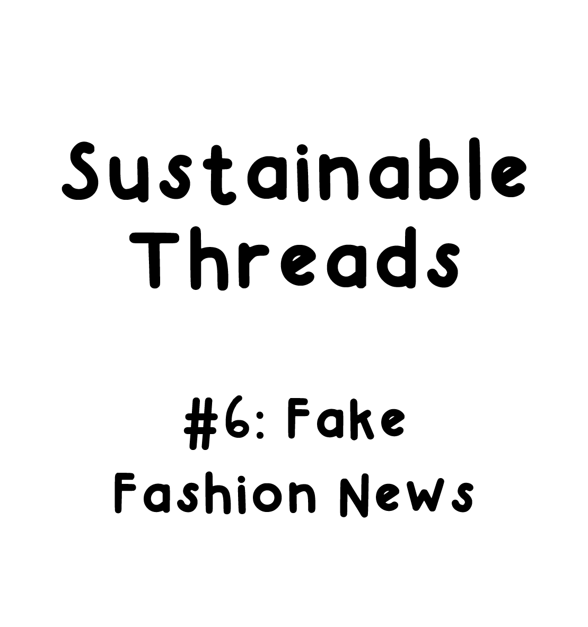
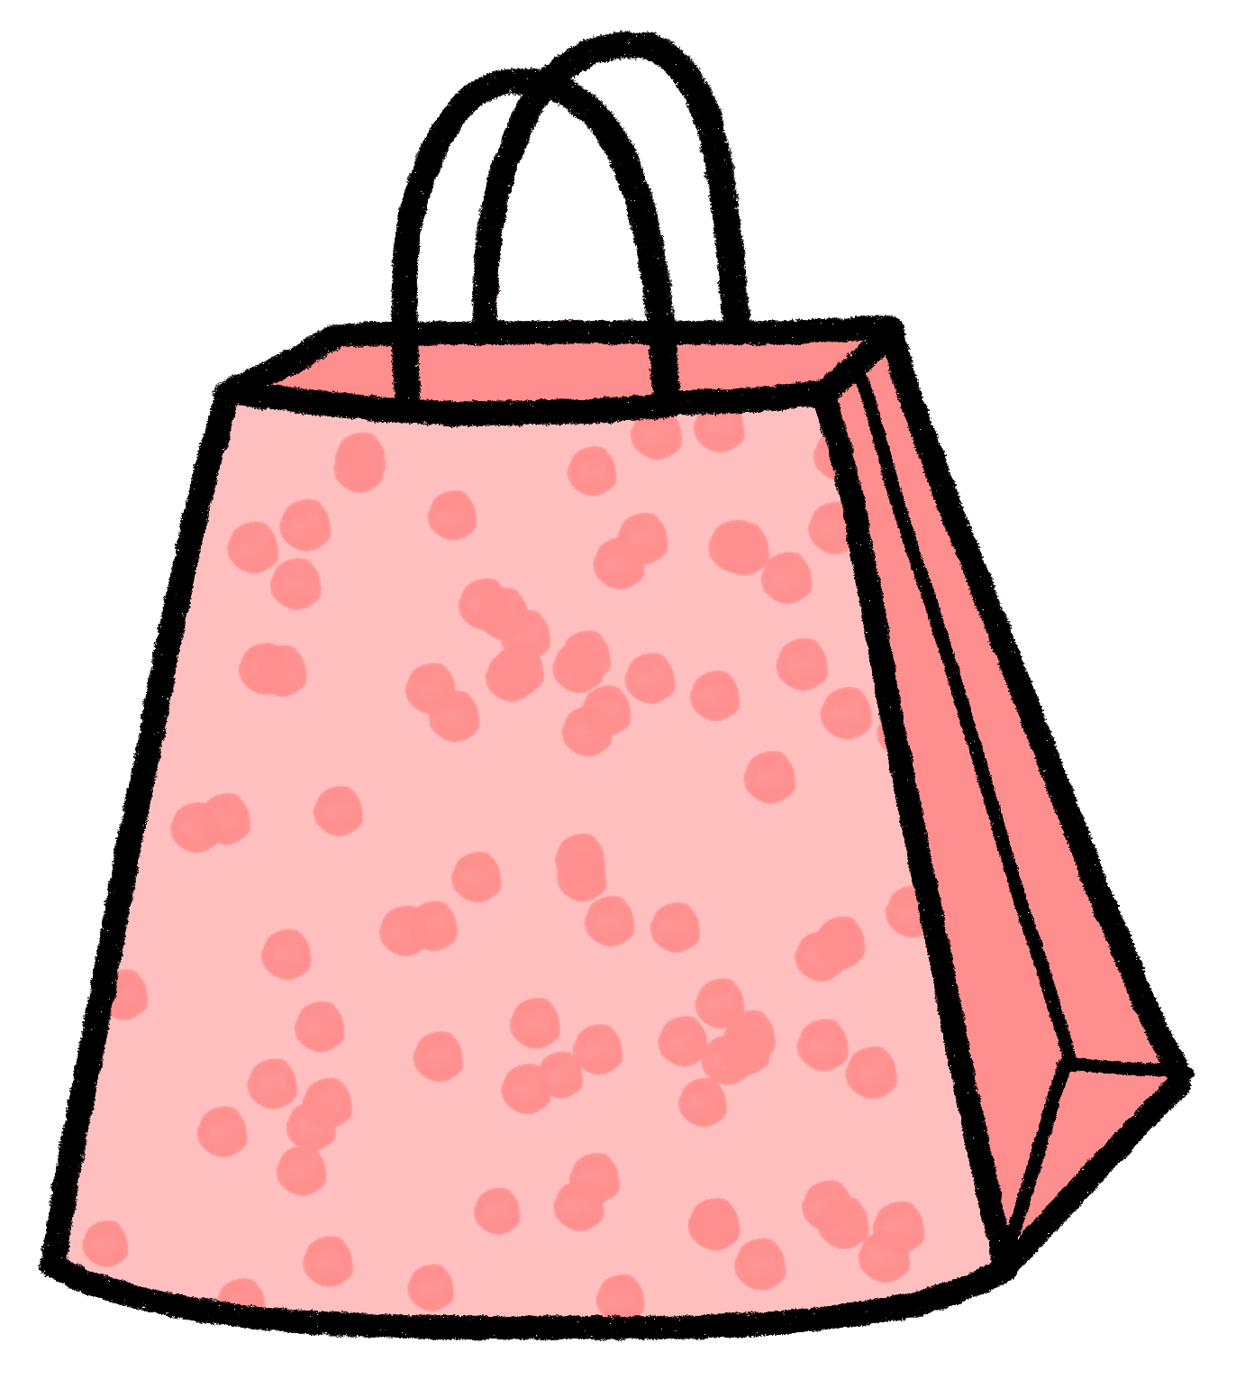

Slide 2
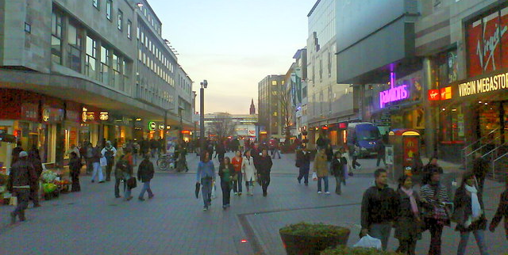
Task 1 : As a group, choose a high street clothing brand to research
You could do this by looking back at Section 1 : What’s on a label? and choosing from the brands you looked at there
You could choose a brand you know, wear or have heard of in the news or in recent advertising campaigns
You could choose a brand that has selected lines that they advertise as a more sustainable choice. Searching for ‘sustainable’, ‘ethical’, ‘eco-friendly’ alongside the brand name might help you to choose

Slide 3
Task 2 : Once you have decided which brand to look into, look for adverts for that brand. Look online, in magazines and at videos.
Collect these together in a way that makes sense to you, on a noticeboard or by collecting links to webpages together.

Slide 4
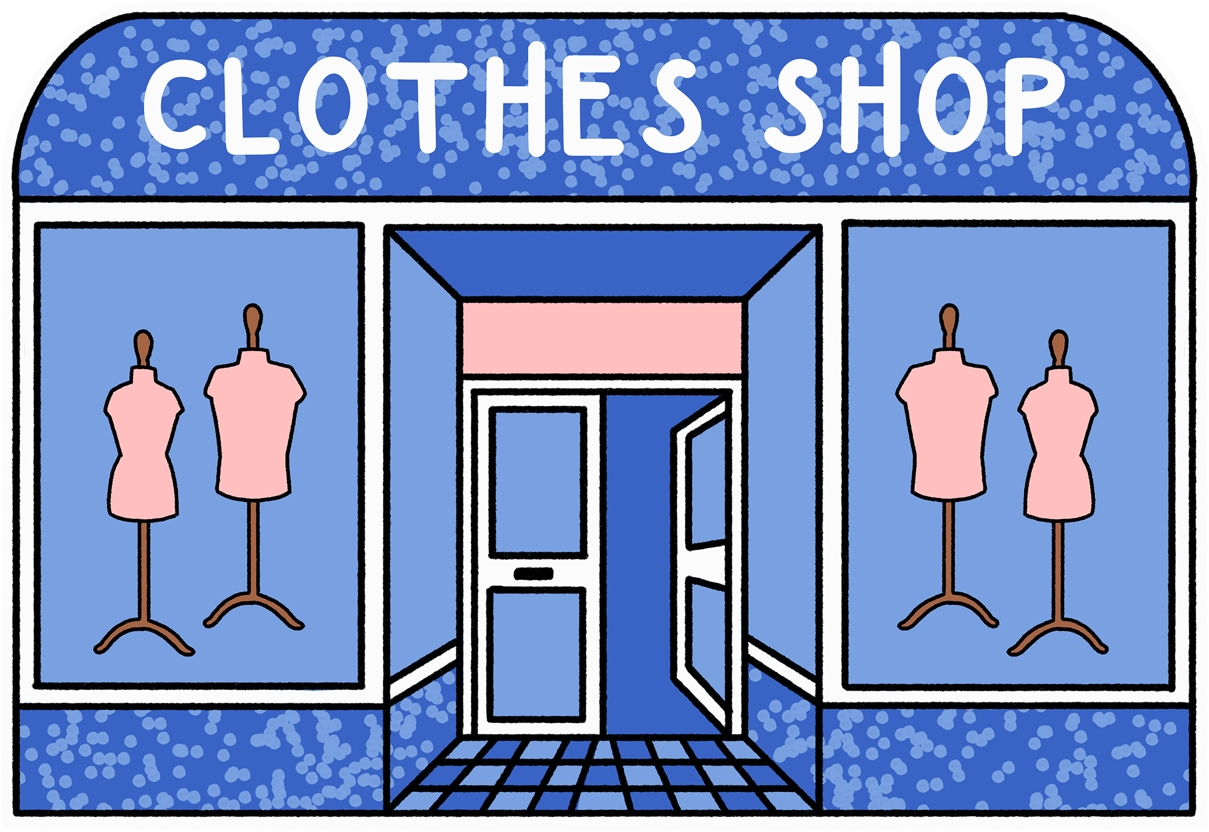
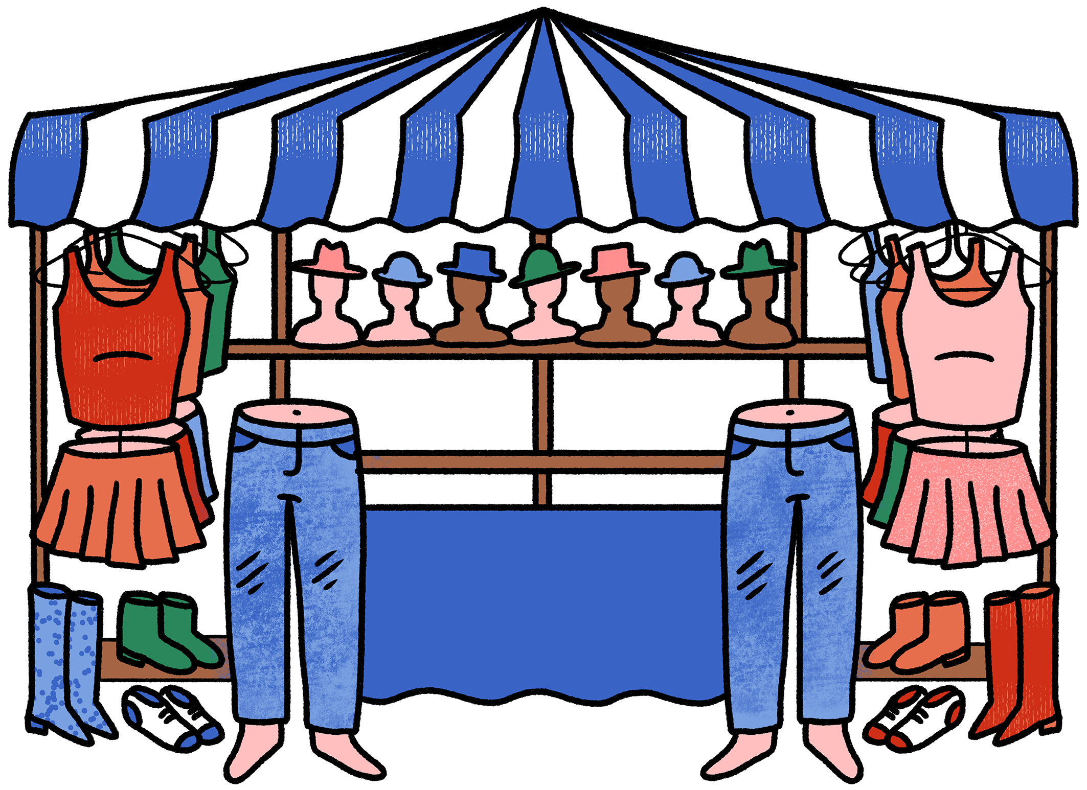
Task 3 : What do the adverts tell us? Think about the following:
What is the advert trying to sell?
What image is being portrayed?
Does the advert make you feel anything? What? Happy? Sad? Like you belong? Something different?
Does the advert link the product with an idea? What?
What messages about ethics / sustainability / personal values are they using within the advert?
Remember to think about any music, spoken words or written text, colours used within the advert
Think about the name of the line that is being advertised as a more sustainable choice. What messages is the name of that line or range trying to communicate?

Slide 5
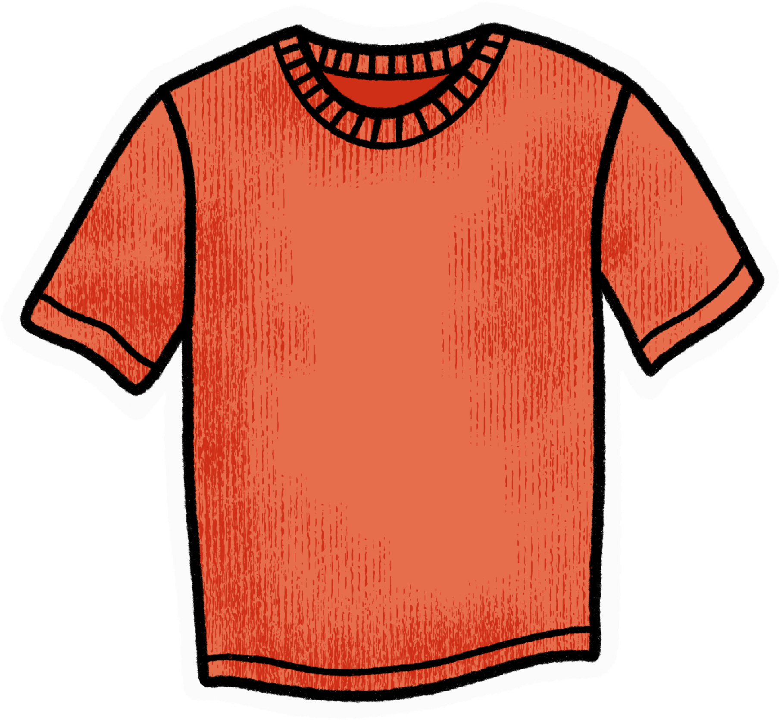
Task 4 : Discuss:
What else do you want to know about how these clothes are made?
Is there anything the company isn’t telling you, the consumer, in the adverts?
Make a list of other information that you would like to know. Think back to What’s behind a label? to help.

Slide 6
Task 5 : Search for a sustainability policy written by the brand you are researching. This is often available on their website
Read the policy.
Does it contain the information you wanted to know after looking at the adverts?

Slide 7
Task 6 : Visit Good on You https://directory.goodonyou.eco/
Search for the brand on Good on You https://directory.goodonyou.eco/and read the review
Visit https://goodonyou.eco/category/rated/ and search for the brand you are researching. You could use ‘ctrl and f’ on your keyboard to speed up your search within the ‘Rating’ webpage
Discuss:
How do you feel about everything you have looked at?
Do the adverts you have looked at compare to the information in the review and the article you found on Good on You?

Slide 8
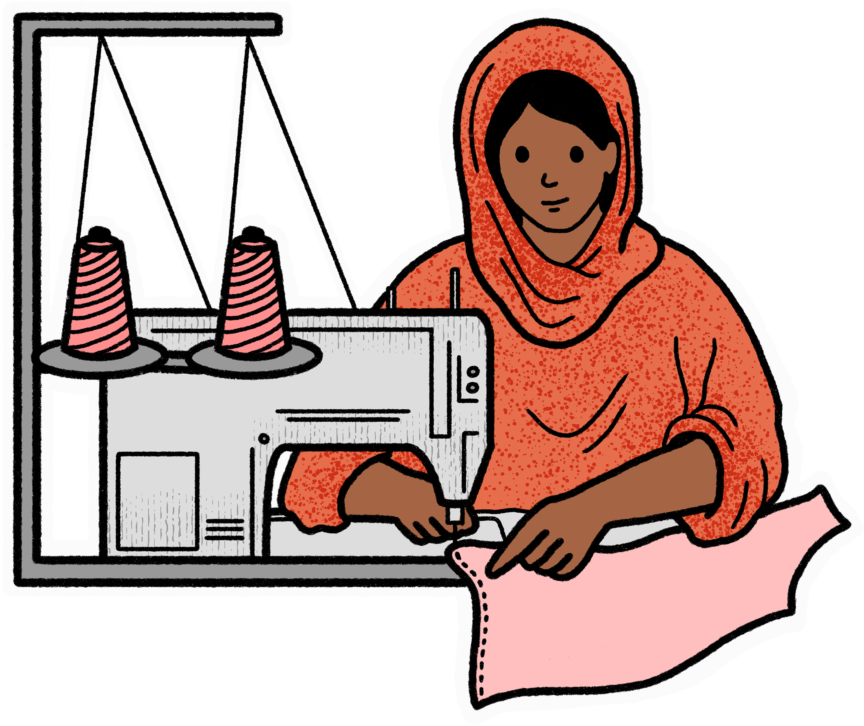
To help you, when you consider which brands to choose from, one tool you can use is the
Fashion Revolution Transparency Index https://www.fashionrevolution.org/about/transparency/
Fashion Revolution explains that:
‘Transparency is the public disclosure of information that enables people to hold decision makers to account. For the fashion industry, it means sharing information about supply chains, business practices and the impacts of these practices on workers, communities and the environment. Transparency is crucial for connecting the dots of the problems in the fashion industry and understanding how to fix them. Transparency is vital for holding major brands accountable for their human rights and environmental impacts across their supply chains.’
Task 7 : Open the 2021 Fashion Revolution Transparency Index using the link above. Navigate to page 38.
Which brands do you recognise?
How do they score on the transparency index?

Slide 9
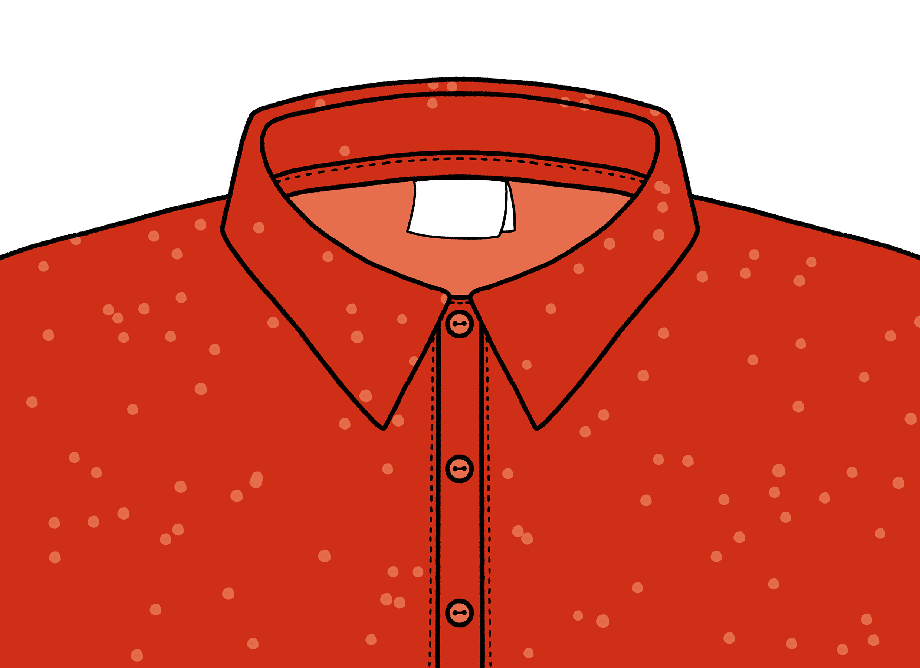
Discuss:
How many brands scored over 80%?
How many brands scored 0%?
Why do you think this is?
How could high street brands improve their rating?
What actions do brands need to take?

