Slide 1
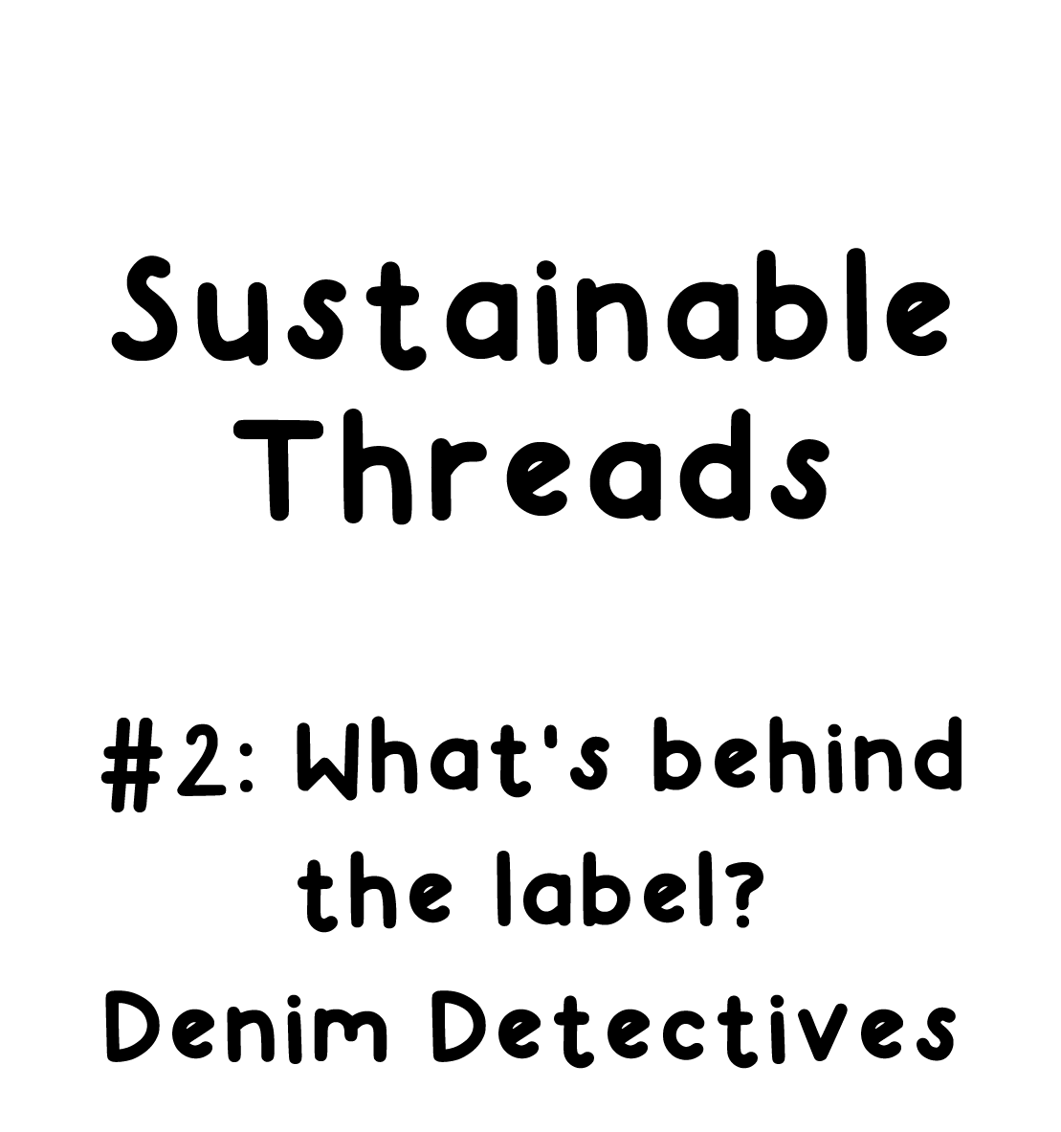

Slide 2
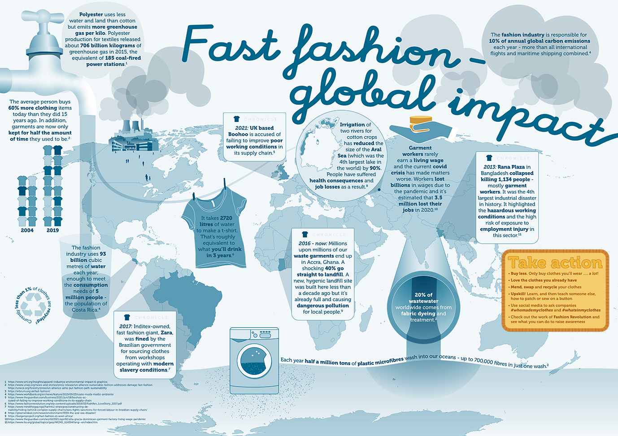
Task 1:
Read the information in this poster.
Does anything surprise you? Discuss with a partner.
Using this information, can you list 3 ways that garment production/ fast fashion impacts the planet as shown on the poster?
What do you understand by the phrase ‘fast fashion’?
Produced by the University of Birmingham, School of Geography, Earth and Environmental Sciences
We have provided a larger PDF version of this map within the downloadable resource.
Use the zoom in function within the PDF to view text if necessary.

Slide 3
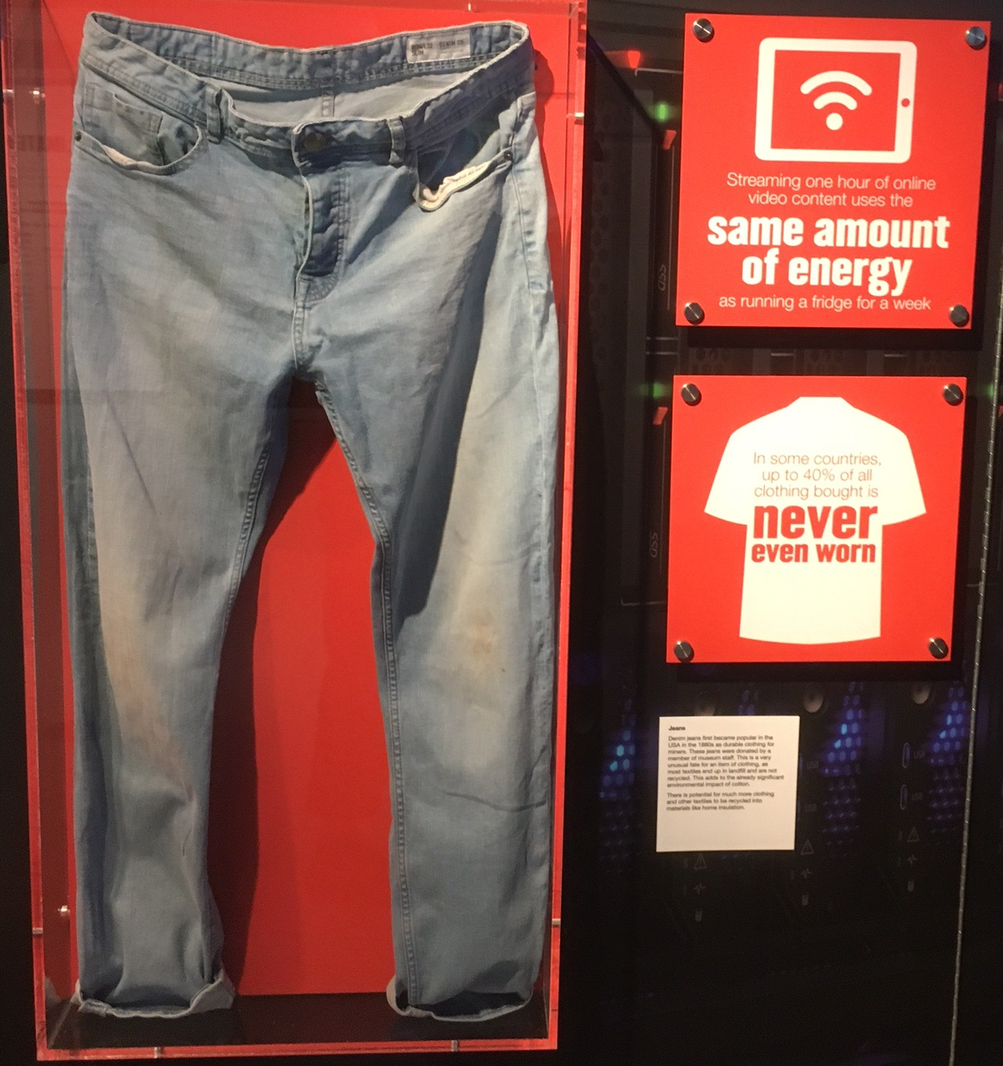
This pair of jeans is displayed in Our Changing Planet gallery at Thinktank, Birmingham Science Museum. They are displayed with this information, to help visitors learn about the impact of garment production (making clothes) on the planet.
Jeans
Denim jeans first became popular in the USA in the 1880s as durable clothing for miners. These jeans were donated by a member of museum staff. This is a very unusual fate for an item of clothing, as most textiles end up in landfill and are not recycled. This adds to the already significant environmental impact of cotton.
There is potential for much more clothing and other textiles to be recycled into materials like home insulation.
Let’s delve deeper to find out more……………..

Slide 4
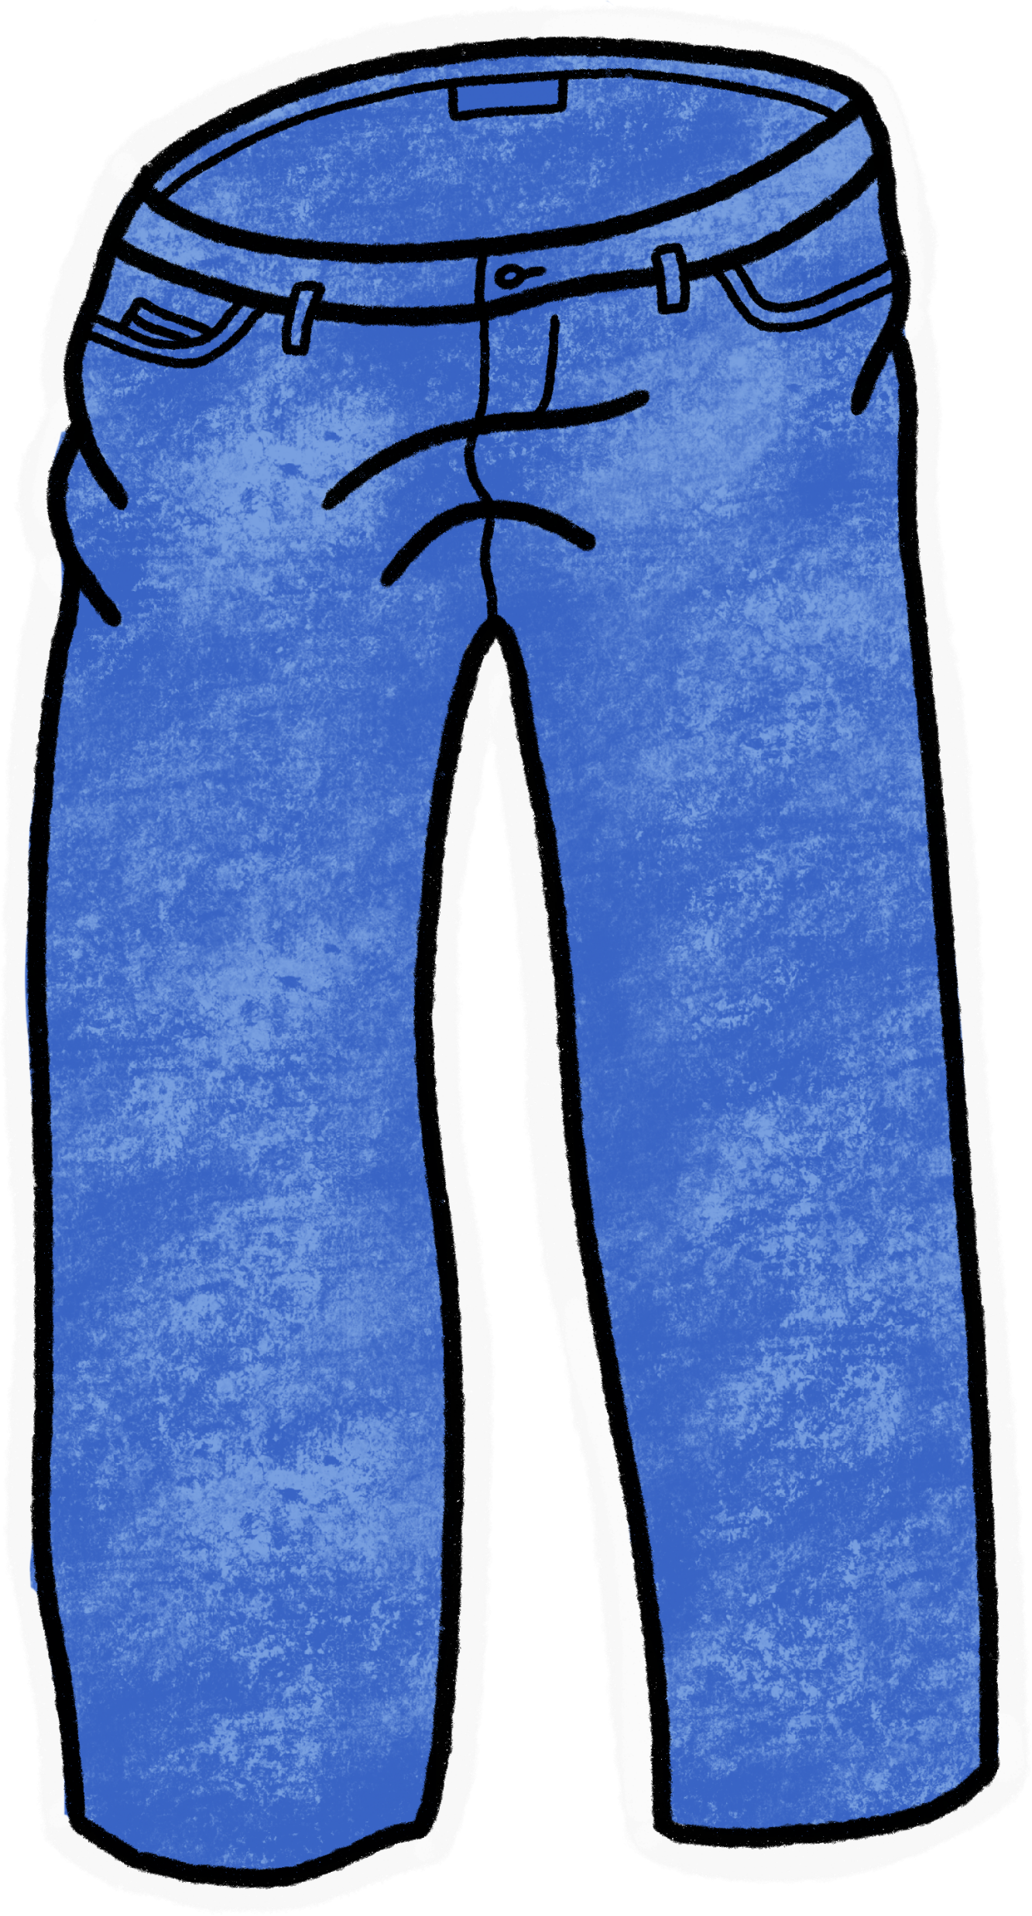
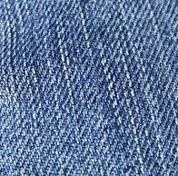
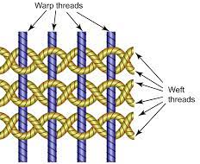
The clothes we wear have personal stories. This is the story of this pair of jeans.
These jeans were donated to Thinktank, so we know a little bit about the person who owned them.
They belonged to a man called Mark Ashford. He bought them in 2015 from Primark and says ‘they weren't expensive, about £12.’ We also know about how he felt about them, and some of the occasions he wore them.
They were initially worn as smart jeans for evenings out like his son’s stag do and another son’s thirtieth birthday. After a couple of washes the fit wasn't great anymore so Mark decided to buy some new, slightly more expensive ones. They then became what Mark calls 'work wear', meaning clothes set aside for when doing DIY that he doesn't mind getting dirty. They were used like this for the last few years until being donated to ‘Our Changing Planet’ gallery in summer 2021.
What is denim?
Denim is a strong fabric made from cotton. It is made with a twill weave, and is warp-faced. The threads going right to left (called the ‘weft’) passe under two or more threads going up and down (‘the warp’). This method of weaving gives denim a subtle diagonal pattern.
Find out more here: https://en.wikipedia.org/wiki/Denim
Why do so many of us wear denim?
Denim was first made as study workwear, Hollywood films introduced them to the world, and they have been an important part of fashion since the 1950s. But we still want to know more.............

Slide 5
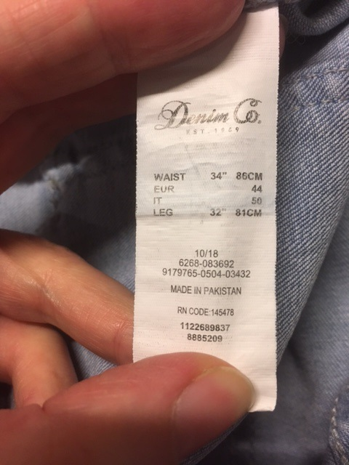
Inside the jeans is a clothing label, with this information on.
So we know that the jeans were made in Pakistan. And what materials they are made from:
Shell: 98% cotton
2% elastane
Lining: 48% cotton
52% polyester
There are also 4 metal buttons, but there is no information about those on the label.
So we know what materials they are made from.

Slide 6
We still want to know:
Where did the raw materials come from?
What are the environmental impacts of farming/making those materials?
What are the environmental impacts of wearing clothes made from those materials?
How was the garment transported to the UK?
How has the production and transport of these jeans affected our planet?

Slide 7
Task 2: In your group, research one of the raw materials used to make the denim jeans and how that raw material impacts on the environment.
Plan how you will share your knowledge with the whole group for Task 3.

Slide 8
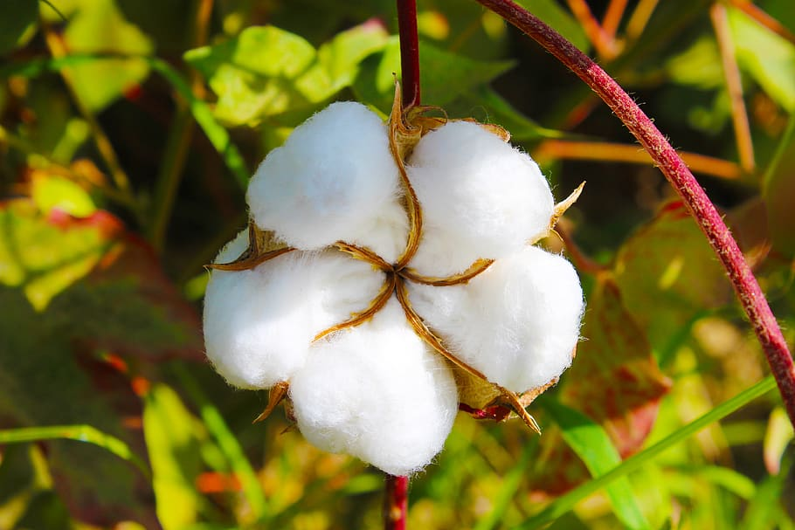
98% cotton, so what is cotton?
Cotton is a natural material that grows around the seeds of the cotton plant.
The fibre can be spun into a thread and woven into a fabric. You can learn more here: https://en.wikipedia.org/wiki/Cotton
It is farmed in lots of countries, but the largest exporters of cotton are USA (36%) and India (15%)
A cotton ‘boll’ growing on the cotton plant. This seed pod is removed from the plant so the cotton fibres can be removed and used.

Slide 9
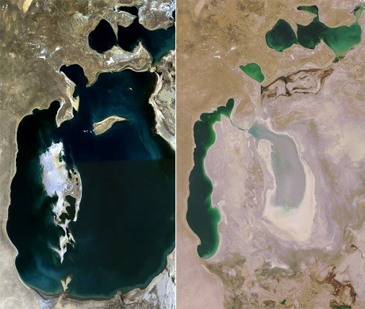
What is the environmental impact of cotton?
Growing cotton consumes 6% of all agricultural chemicals and 16% of all insecticides produced globally. Insecticides kill pests that threaten the crop, but they also wipe out a whole host of important creatures in the ecosystem, they damage soil, infiltrate into water systems and have a negative impact on aquatic life.
Cotton is a very thirsty crop to grow, requiring over 7,000 litres of water to produce just one pair of jeans. Irrigation of two rivers for cotton crops has reduced the size of the Aral Sea (which was the 4th largest lake in the world) by 90%.
Approximately 70 per cent of lakes and rivers across Asia are polluted by the toxic chemicals and waste water produced by the continent’s textile industry.
A comparison of the Aral Sea in 1989 (left) and 2008 (right). Use of the water from the Aral Sea for irrigation has reduced its size by 90%.

Slide 10
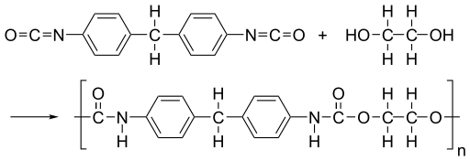
2% Elastane, so what is Elastane?
Elastane is also called by the brand names Spandex and Lycra. ‘Spandex’ is an anagram of ‘expands’.
It is a synthetic fibre made of a long chain polymer called a polyester-polyurea copolymer. You can learn more here: https://en.wikipedia.org/wiki/Spandex
Elastane is petroleum based, so is made from non-renewable fossil fuels.
The largest exporters of Elastane are China, USA, and Germany.
The chemical structure of elastane

Slide 11
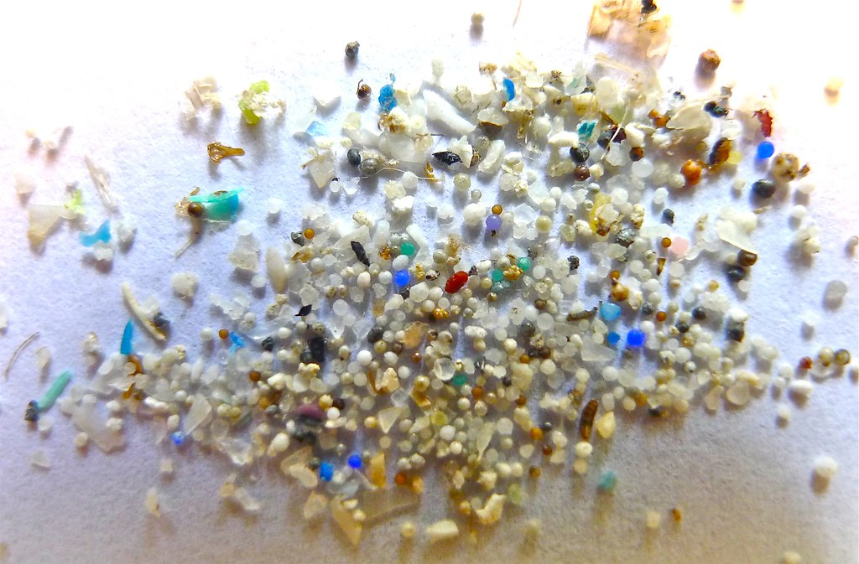
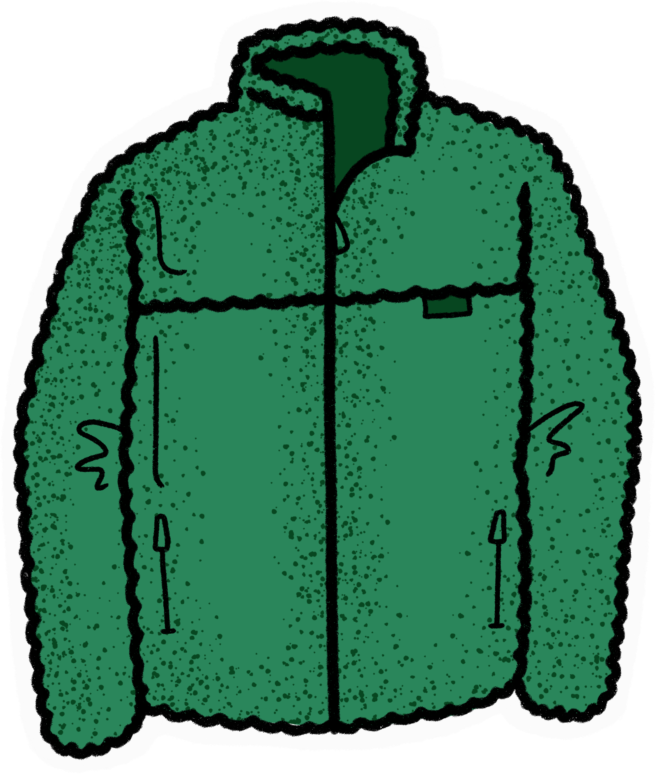
What is the environmental impact of Elastane?
Elastane is petroleum based, so is made from non-renewable fossil fuels. Extracting and using fossil fuels like petroleum carries risks, including the potential for oil spills. Extraction can also lead to methane emissions which affects the Earth’s atmosphere, and the infrastructure connected with this industry can also disrupt wildlife and lead to biodiversity loss.
Elastane is synthetic so is not biodegradable. When washed, clothes made of elastane shed microfibres. Microfibres are extremely small pieces of plastic resulting from the disposal and breakdown of synthetic products. Microplastics cause pollution of natural ecosystems, including marine habitats. Each year half a million tons of plastic microfibres wash into our oceans - up to 700,000 fibres in just one wash.
Microplastics are extremely small pieces of plastic that pollute natural environments.

Slide 12
The lining is 52% Polyester, so what is Polyester?
Polyester (polyethylene terephthalate) is derived from a chemical reaction involving petroleum, air, and water.
Polyester is a synthetic material.
Polyester fibres are sometimes spun together with natural fibres to produce a cloth. You can learn more here: https://en.wikipedia.org/wiki/Polyester
The largest exporters of Polyester are China, Indonesia, India, Germany, USA, Netherlands.
The chemical structure of polyester

Slide 13
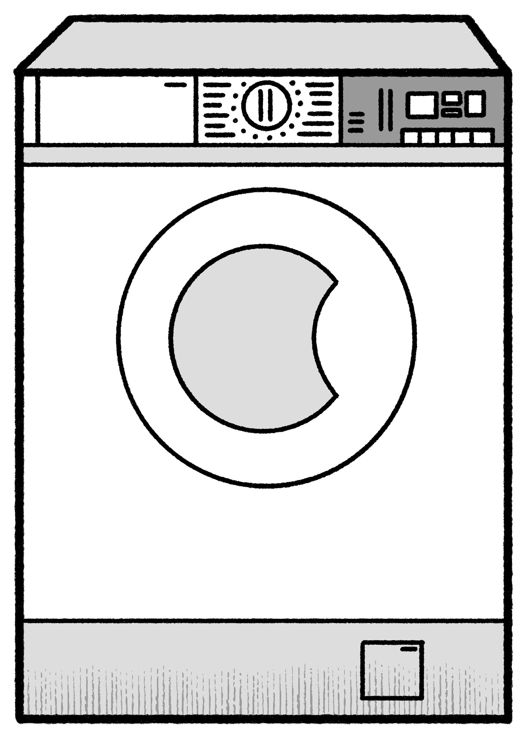
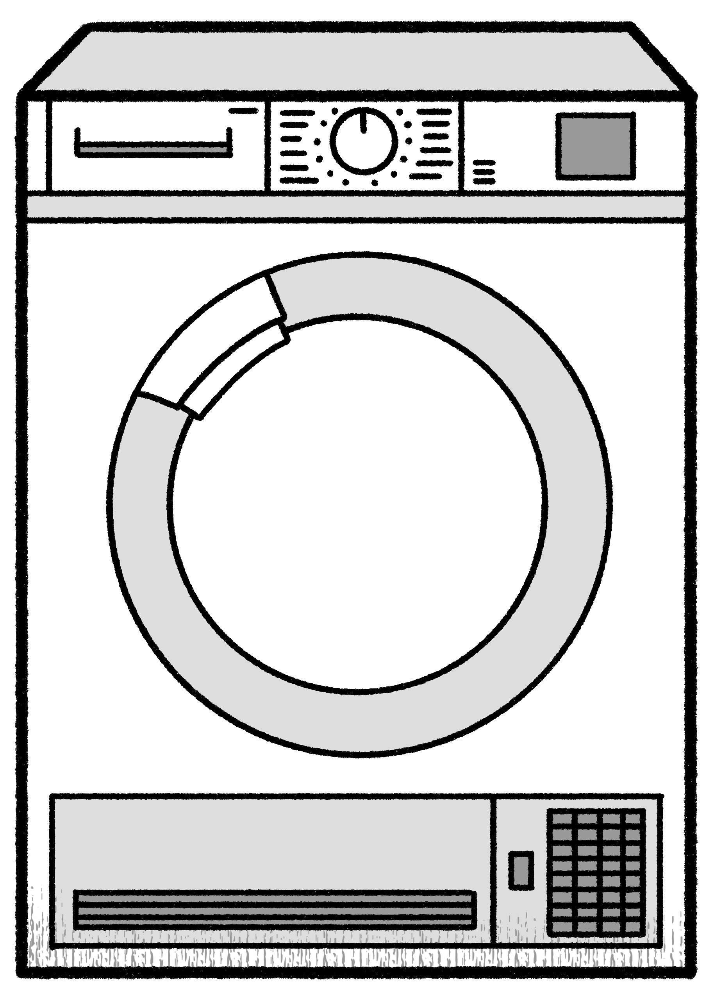
What is the environmental impact of Polyester?
Polyester uses less water and land than cotton but emits more greenhouse gas per kilo. Polyester production for textiles released about 706 billion kilograms of greenhouse gas in 2015, the equivalent of 185 coal-fired power stations.
When laundered, polyester sheds microfibres. Each year half a million tons of plastic microfibres wash into our oceans - up to 700,000 fibres in just one wash.
Synthetic fabrics are usually produced from oil and account for 63 per cent of the material input for textiles production. The most common materials in this sector are polyester (55%), followed by nylon (5%), and acrylic (2%).
Polyester fibres take a really long time to biodegrade. It could take more than 200 years for a dress made of polyester to biodegrade.
Microplastics are extremely small pieces of plastic that pollute natural environments.

Slide 14
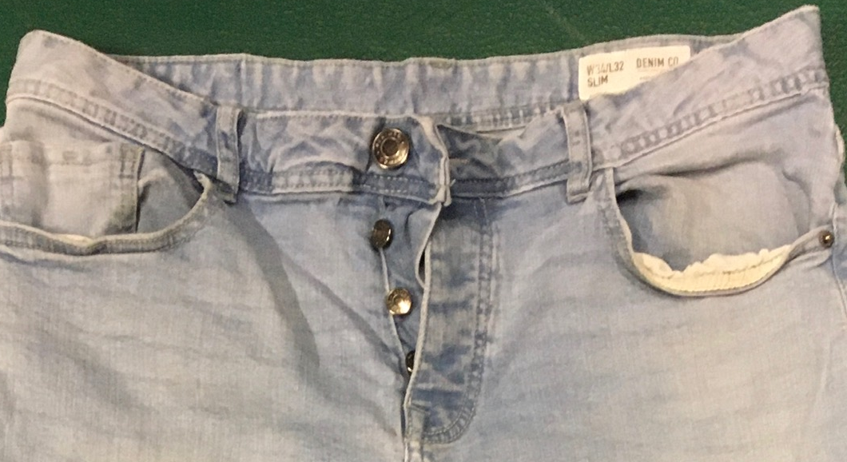
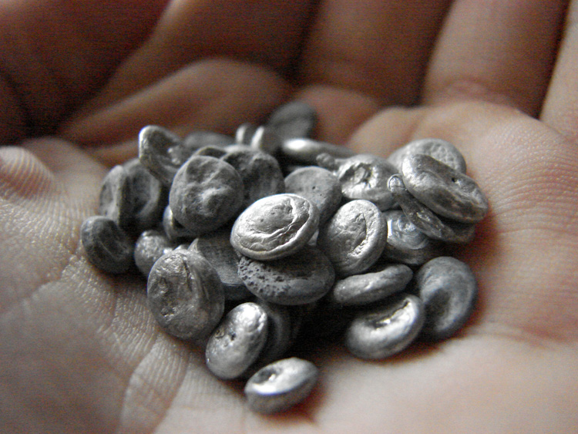
What about the 4 buttons? These aren’t listed in the materials list on the label, but they feel like metal. So let’s look it up…..
https://www.sbs-zipper.com/blog/what-are-the-manufacturing-materials-of-metal-buttons/
So, the 4 buttons might be Zinc Alloy, so what is Zinc Alloy?
A zinc alloy is made out of a mixture of zinc and aluminium.
Both zinc and aluminium are mined. 80% of zinc is mined underground from rocks in the Earth’s crust. Aluminium can be mined from underground and open-pit mines, and is hidden in an ore called bauxite.
After mining, zinc and aluminium need to be extracted and processed so they can be used.
The largest exporters of zinc are South Korea, Belgium and Canada. The largest exporters of aluminium are Canada, Australia, China.
The buttons on the jeans.
Small pieces of zinc alloy.

Slide 15
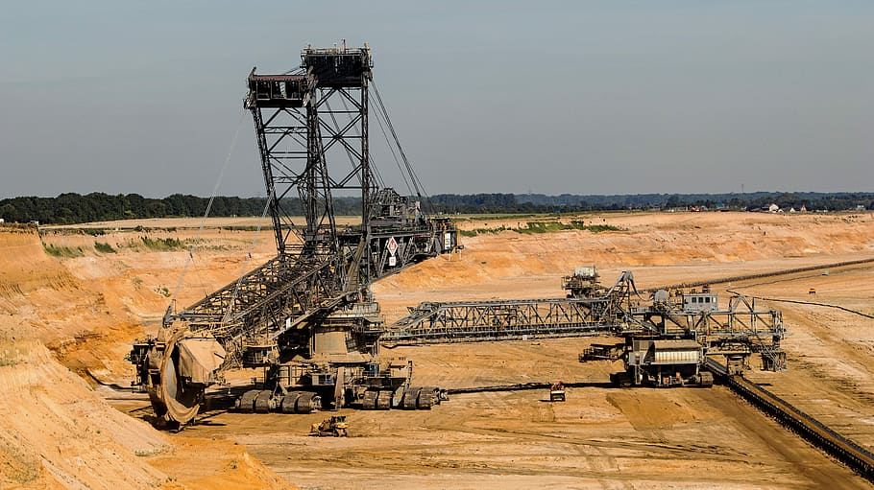
What is the environmental impact of Zinc Alloy?
Lots of aluminium is mined from open pit mines, meaning large areas of land are cleared and bulldozed to get to the bauxite. Clearing the land means cutting down trees and removing grassland and this results in habitat loss for plants and animals. It can also result in soil erosion. Mining and refining uses a lot of energy, resulting in CO2 emissions.
Zinc processing results in unwanted by-products that are corrosive and toxic to humans and animals. Processing results in high CO2 emissions. Waste products from heating zinc can result in water pollution, affecting water living species.
An open pit mine which results in habitat loss.

Slide 16
Task 3: Share your learning about the materials used to make a pair of jeans and the effect of using these materials on our planet.

Slide 17
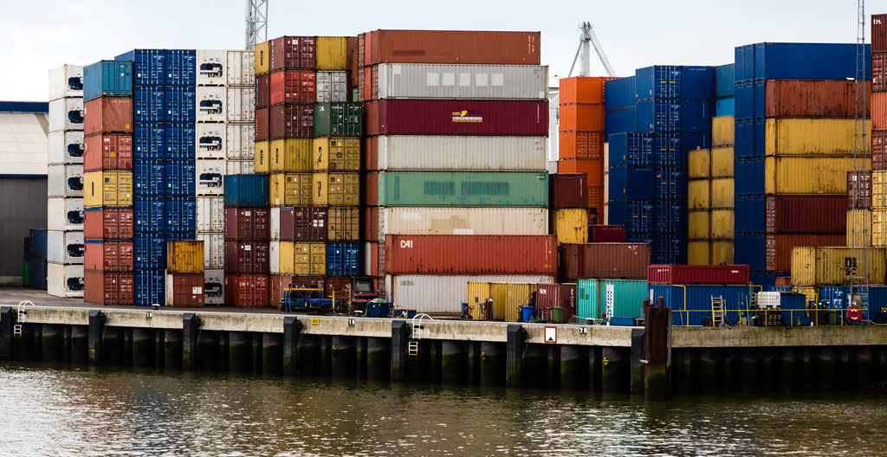
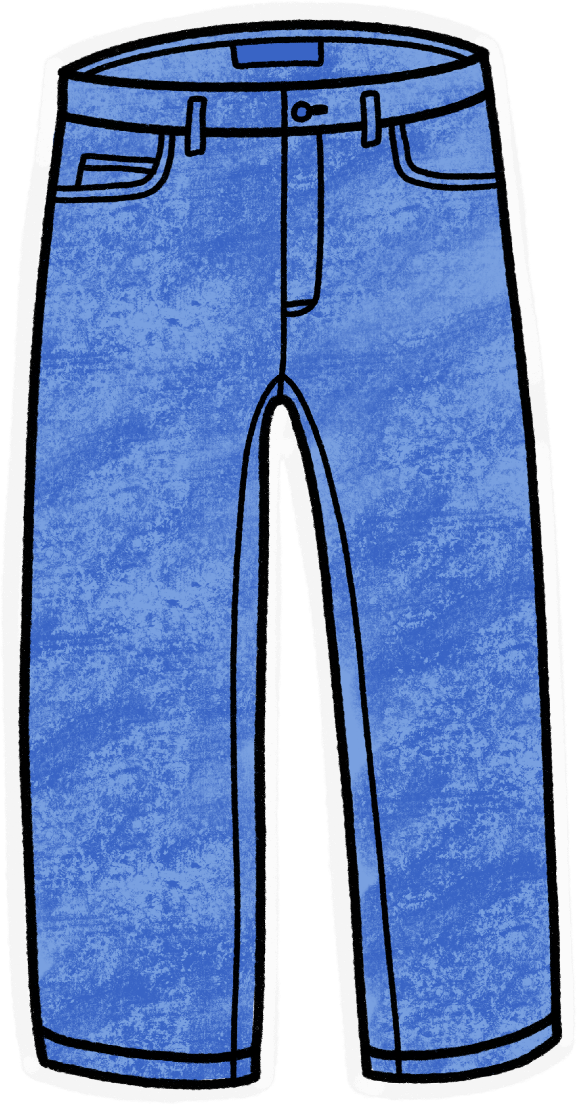
Have you noticed?
None of these raw materials are likely to have been made in Pakistan, but the jeans were. So how did all those materials get to Pakistan?
And how did the jeans get to the UK?
Probably in one of these, a shipping container.
So now you know this, let’s think about the choices we can make.

Slide 18
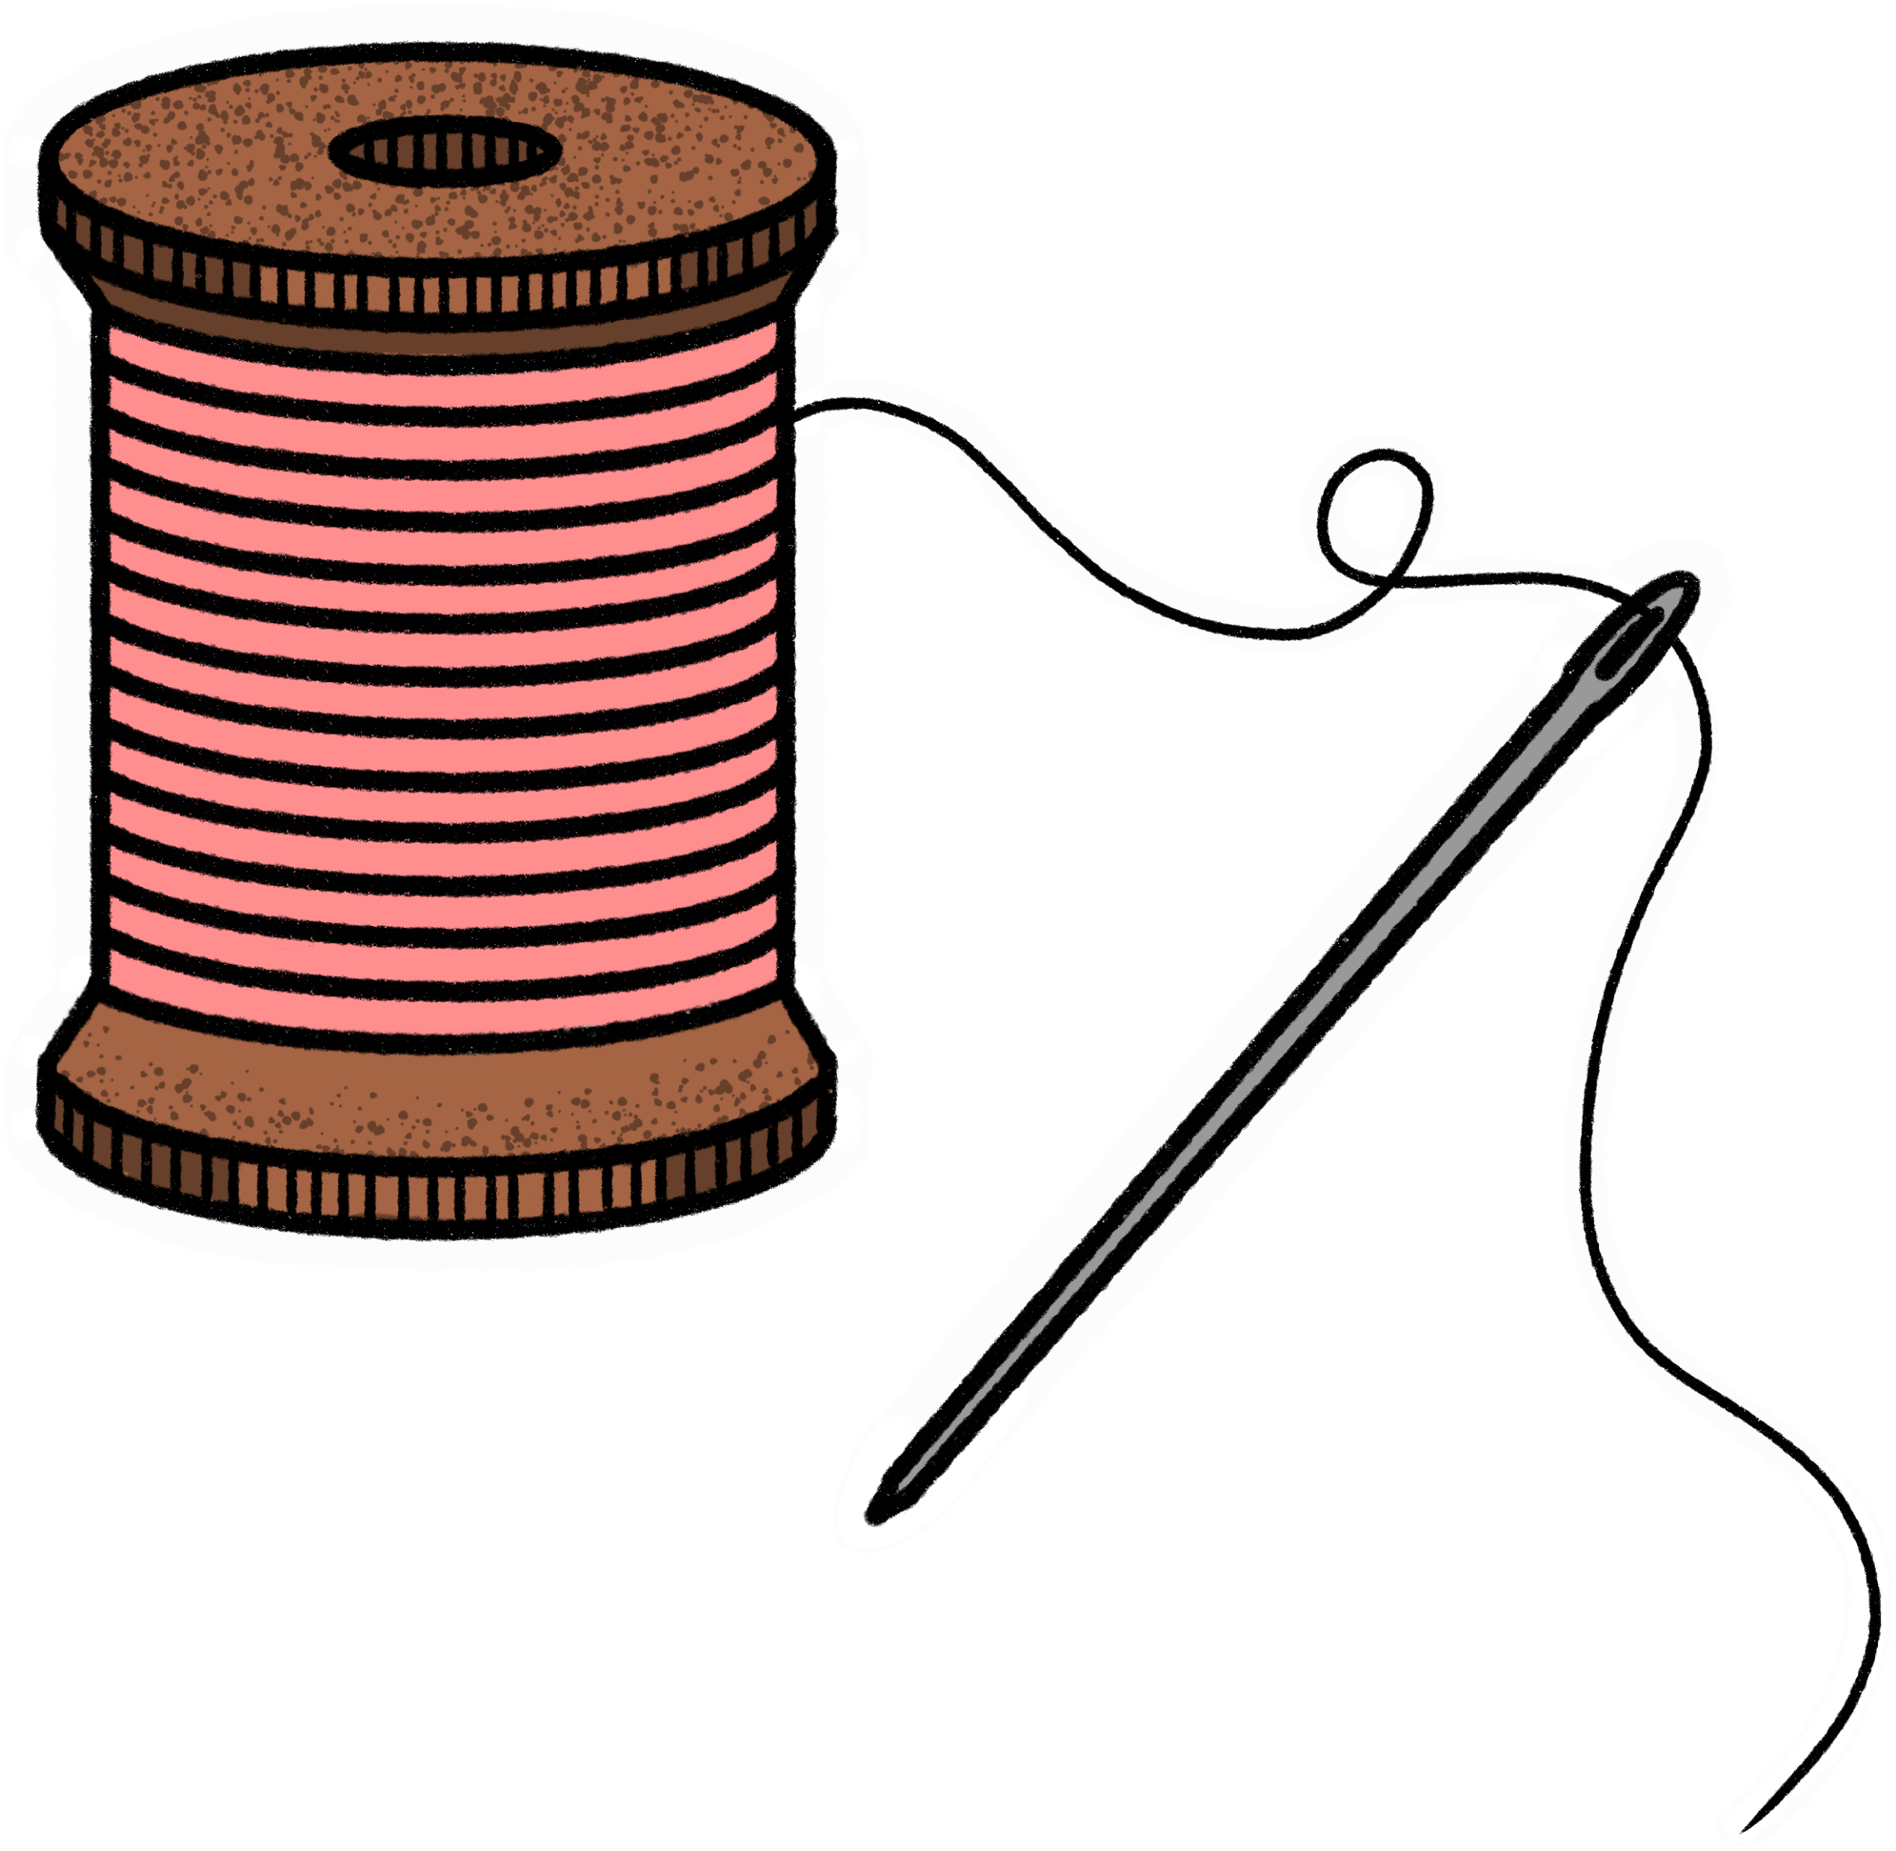
Consumers drive the fast fashion industry. How can you make different choices?
Jeans were designed to be hardwearing and long lasting. Try and wear the jeans you already have for as long as possible.
Consider looking for second-hand or vintage next time you need to buy.
If you do buy new, do some research and see how transparent brands are about the garments they produce. Use the Fashion Transparency Index 2021 created by Fashion Revolution.
Try and find jeans that are 100% cotton, not made from fabrics with synthetic fibres like elastane. Let jeans be jeans and leggings be leggings! Mixed fibres are hard to recycle because they need to be separated. Mixed fabrics therefore often get ‘downcycled’. The recycling process is also often exported to other countries. This itself then results in more global transportation of garment related goods.
Let your jeans distress naturally as you wear them. Artificially distressed jeans use more chemicals, resources and (often exploitative) human labour to produce.
While you have your jeans, try to wash them less frequently. Levi’s suggests washing them once every 10 wears at most to maintain fit and prevent too much "rebound." Spot clean using a damp cloth or old toothbrush with mild soap to remove small stains instead of washing them. Your jeans will look more unique the longer you wear them between washes.
When you are finished with them, don’t put them into landfill – reuse, swap or donate.

Slide 19
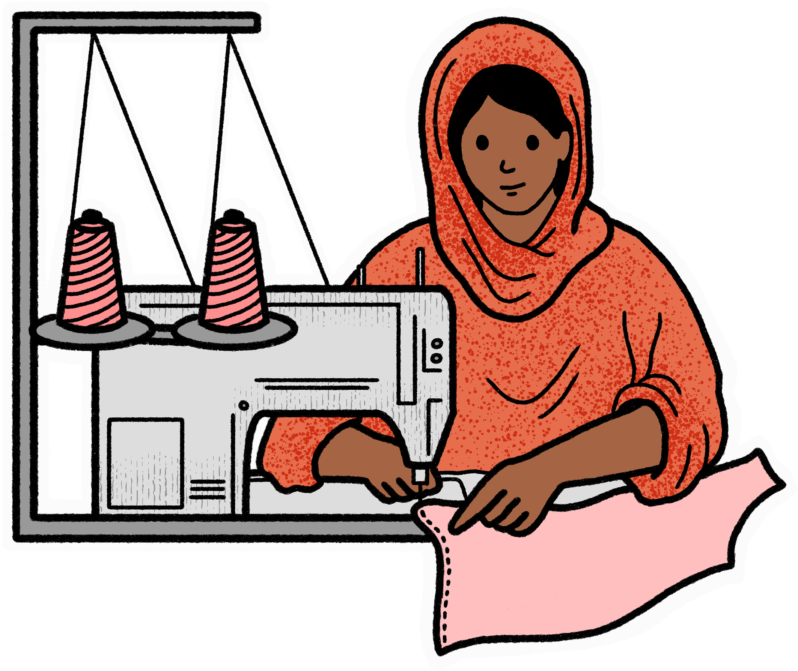
Task 4 : Discuss the following:
Would having more information on the label help you make different choices?
So what should the label say?
What information do YOU want on your clothing labels?

Slide 20
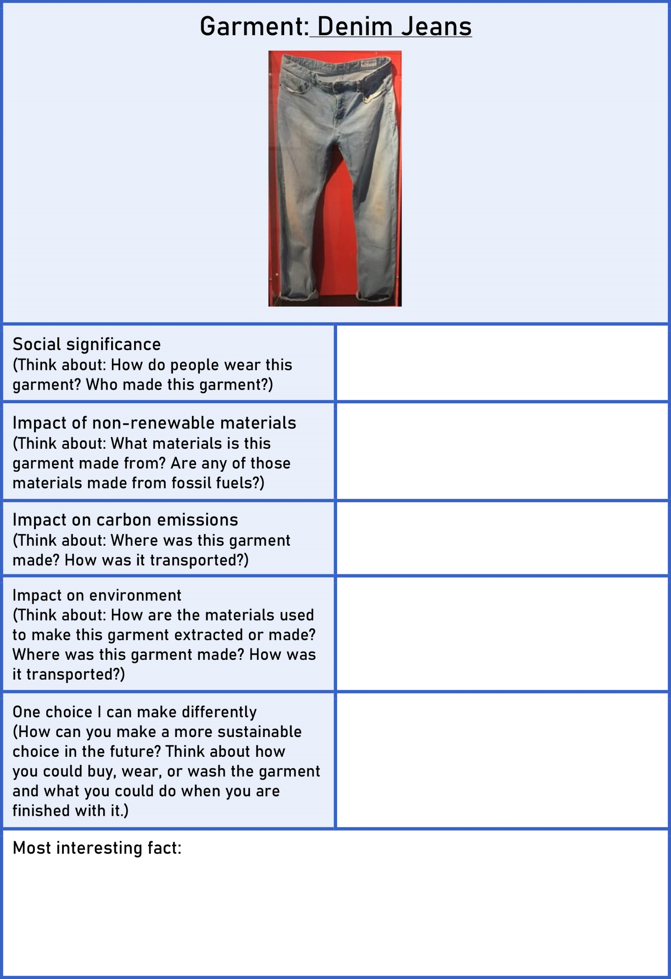
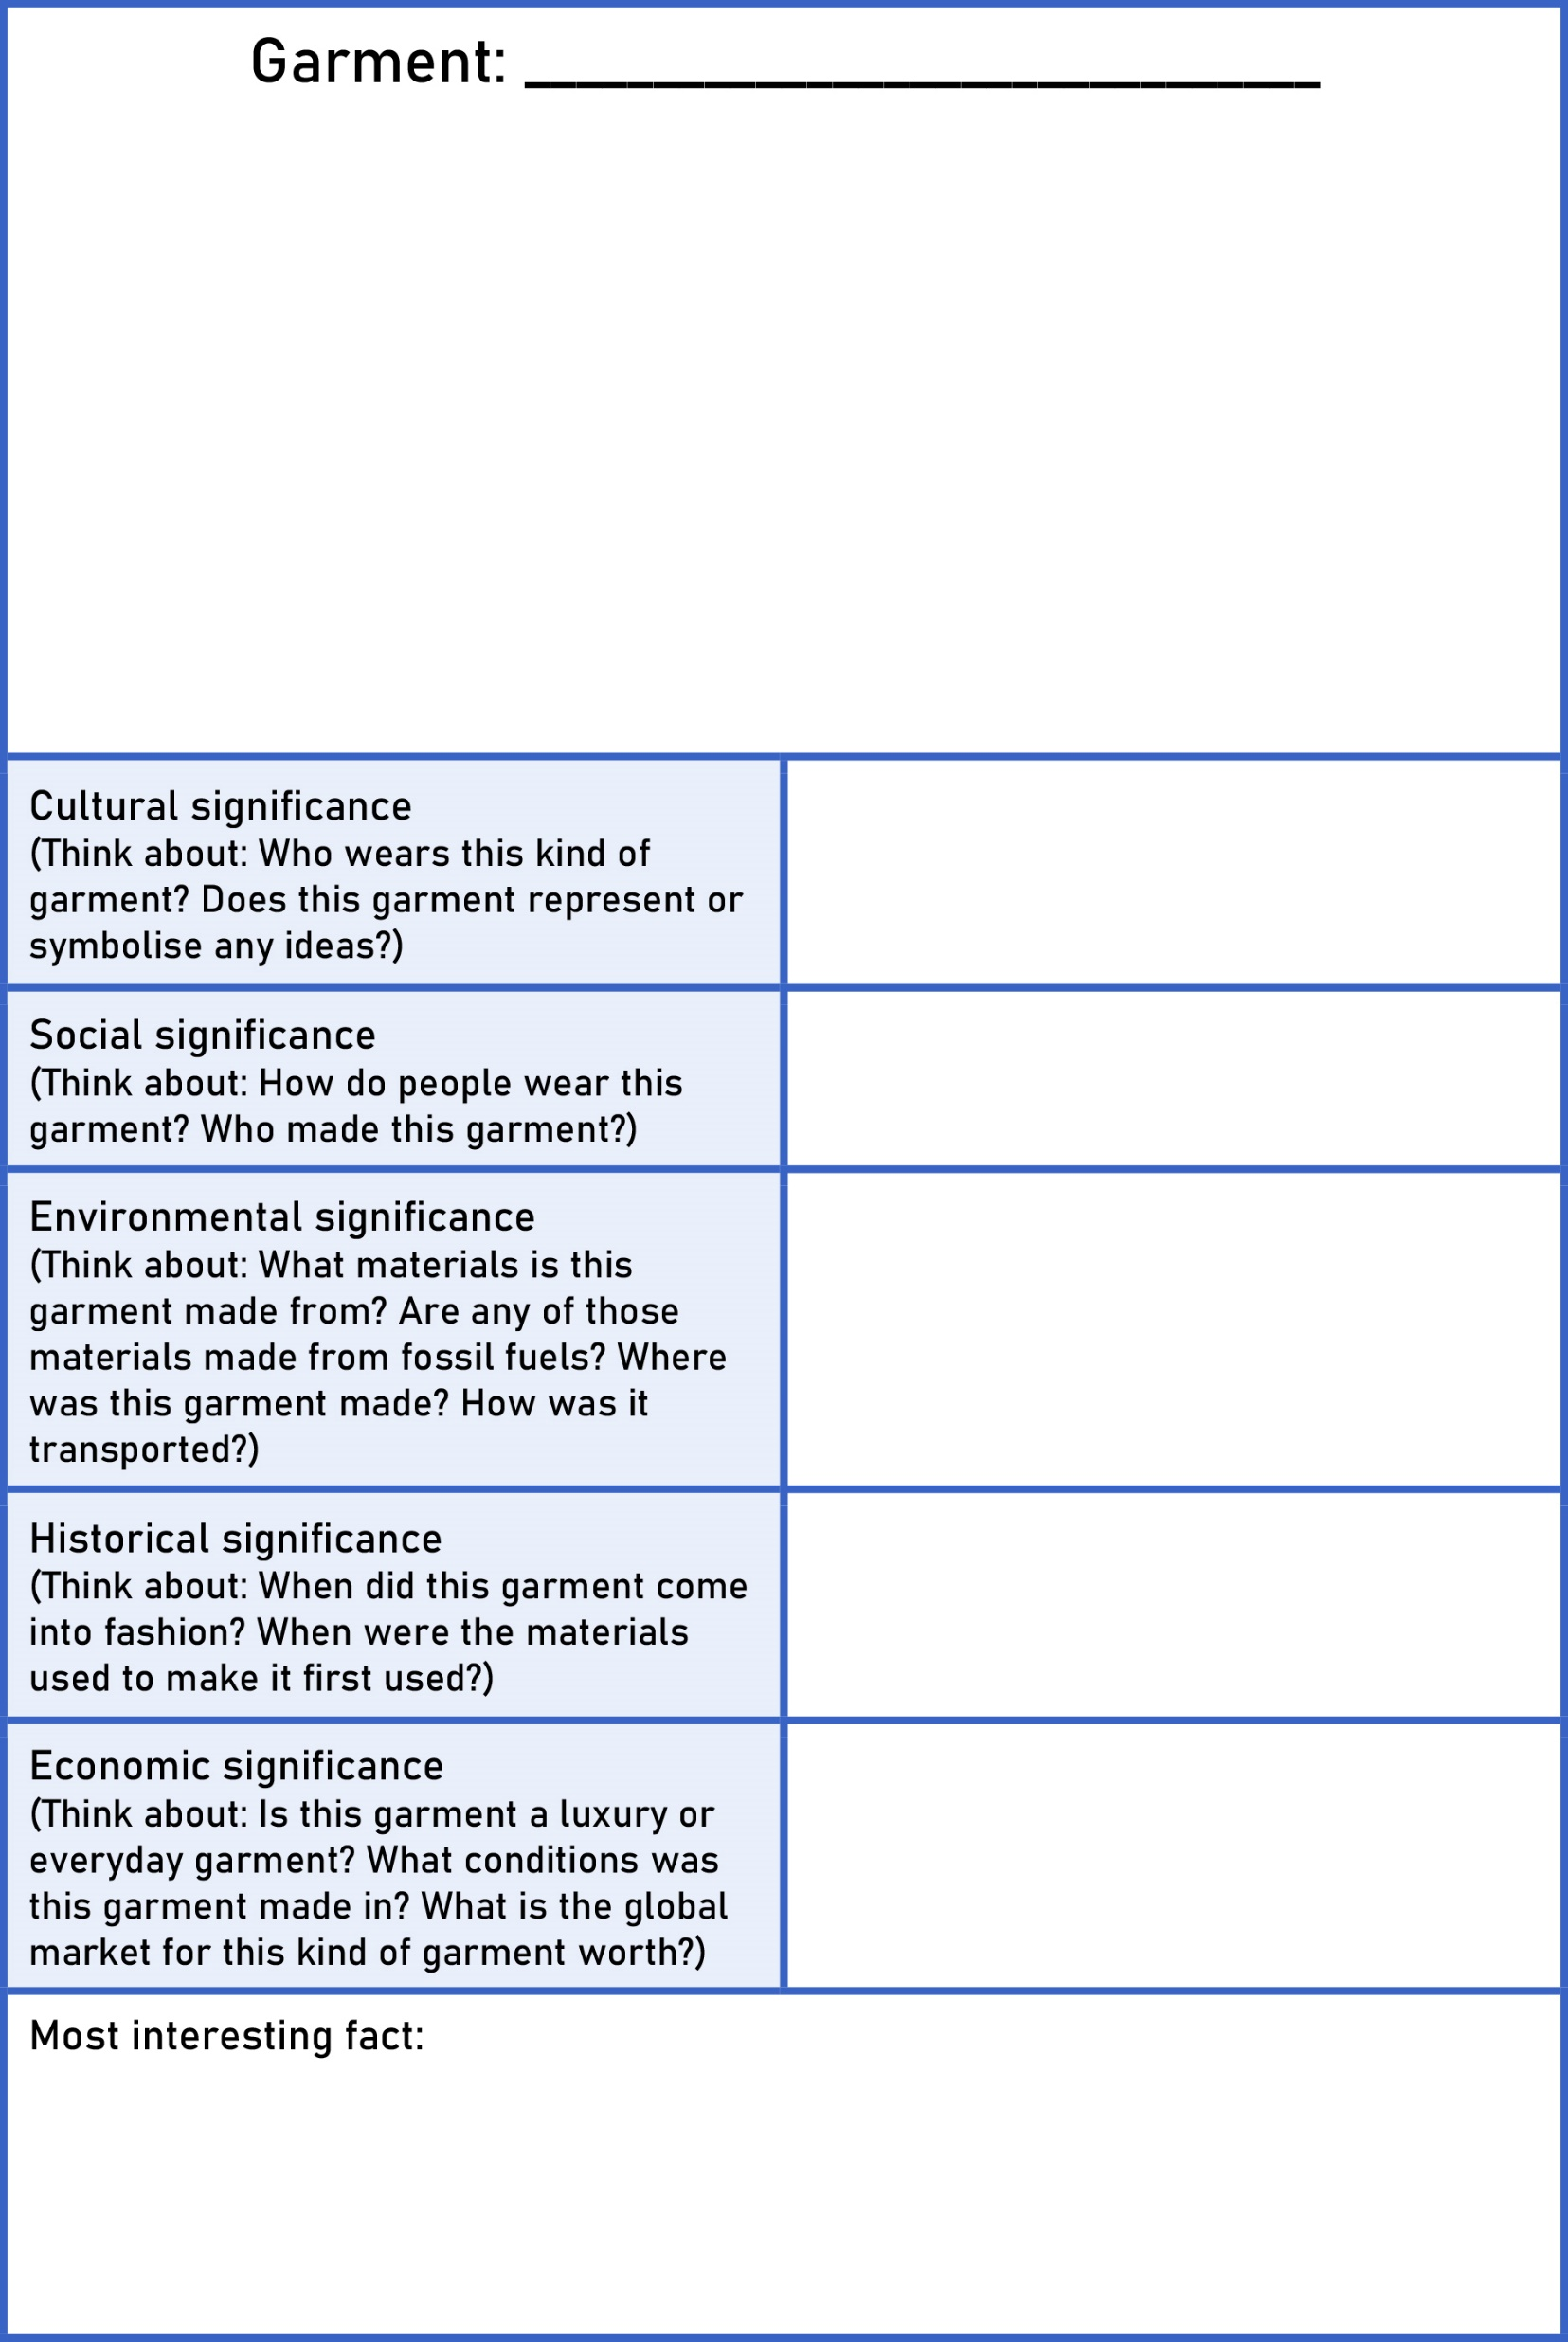
Task 5: Design a Top Trumps card to capture the information you have learnt about the impact of this pair of jeans on our changing planet. You can use any of these templates.

Slide 21
Task 6: Think back to your discussion about fast fashion.
One definition is: ‘inexpensive clothing produced rapidly by mass-market retailers in response to the latest trends.’
Are these jeans an example of fast fashion? Why? Why not?

